Slide 1
Serverless Architecture
Drake Pocsatko ‘19

Slide 2
"The Bulk of Software Engineering in 2018 is Just Plumbing"
Karl Hughes

Slide 3

What is Serverless?
Running code or applications without having to provision and maintain the underlying infrastructure
Servers and infrastructure still exist, but are obfuscated from the developer
Examples: AWS Lambda, AWS Step Functions, AWS S3, AWS API Gateway, AWS SQS, AWS DynamoDB, etc.
Notes:
You can’t escape servers, but you can pretend they don’t exist.

Slide 4
Why Serverless?
Move from idea to market, faster
Lower your costs
Adapt at scale
Build better applications, easier
Notes:
Source: https://aws.amazon.com/serverless/

Slide 5
Serverless Compute
Function as a Service (FaaS)
Runtime environment handled by cloud provider. Developer only needs to write the code they need to run.
AWS Lambda, Azure Functions, GCP Cloud Functions
Notes:
Poll audience for how many have used serverless before

Slide 6
Serverless Compute (cont.)
Serverless Container Platforms
Deploy containers without worrying about provisioning servers for them to run on.
AWS Fargate, Azure Container Instance, GCP Cloud Run
Notes:
Poll audience for how many have used serverless before

Slide 7
Serverless Data
Storage and Database solutions
Object based storage: AWS S3, Azure Blob, GCP Cloud Storage
Database: AWS DynamoDB, AWS Aurora, Azure Cosmos DB, GCP Firestore, GCP Firebase Realtime
Notes:
Add Dynamo table to the serverless file.

Slide 8
Serverless Application Integration
Services that tie your application together
Orchestration – AWS Step Functions
Event Driven Architecture – AWS Event Bridge
Notifications – AWS Simple Notification Service (SNS)
Queuing – AWS Simple Queuing Service (SQS)
Many More

Slide 9
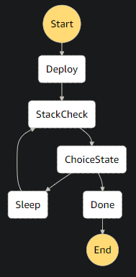
AWS Step Functions
Step Functions provide a way to orchestrate operations in the cloud including Lambda, SQS, SNS, DynamoDB, AWS Batch and more.
Written in Amazon States Language
Documentation: https://docs.aws.amazon.com/step-functions/latest/dg/welcome.html
Notes:
Add basic step function to serverless file.

Slide 10
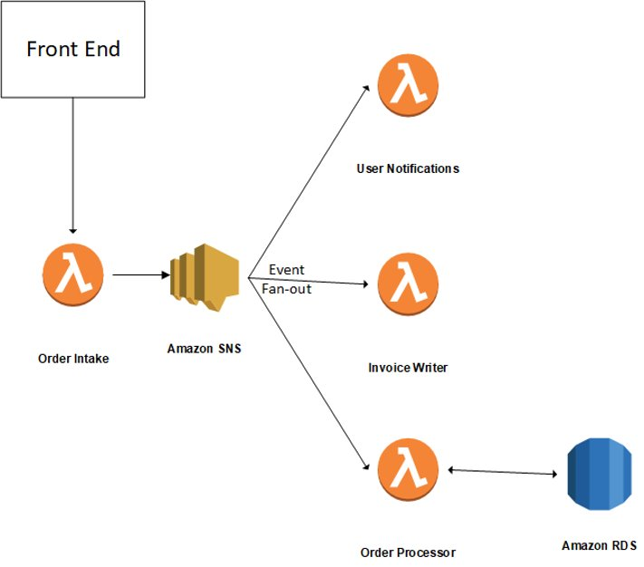
Other Serverless Architectures: Event Driven Back-End
An event driven architecture allows for asynchronous processing of orders for better scalability and stability. Using serverless managed services allows the developer to only need to write code that implements the business logic.

Slide 11
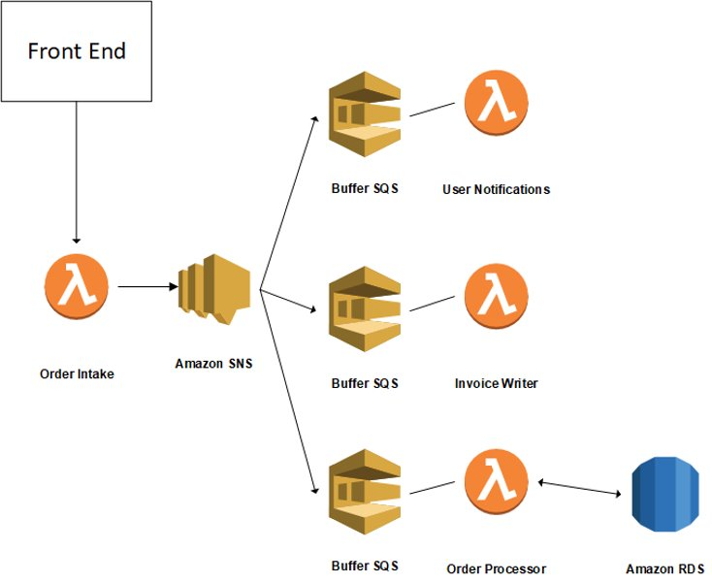
Other Serverless Architectures: Event Driven Back-End
Adding SQS Queues to the architecture allows for buffering between services that run at different rates with minimal code changes needed.​

Slide 12
Questions?

